Slide 1


Lecture No. 12 SOCIETY & CULTURE

Slide 2
1. Specificity of the Philosophical Approach to the Understanding of Society

Slide 3
The concept of "social" is used in two senses: a) broad; b) narrow. In a broad sense, the concept of "social" (from the Latin socialis - to unite, to start joint social work) means:
a) the whole society and the world created by it, in contrast to nature, and the phenomena occurring in it;
b) everything that belongs to social groups, in contrast to what concerns the individual and his qualities. In the narrow sense, it is the existence of a special area of social phenomena (social environment) in which problems affecting the cardinal interests of people (working conditions, living standards, education, health care, social security, etc.) are solved.

Slide 4
As applied to philosophy, the definition of "social" is used in a broad sense, i.e. philosophical comprehension of the essence of society and the processes taking place in it. Social philosophy uses the concept of "society" in the broad sense of the word. However, society is also studied by sociology (from the Latin soci (etas) – society) – the science of society.
In the second half of the twentieth century, the question of the relationship between social philosophy and sociology was sharply discussed. Three points of view have emerged: 1. Social philosophy is equal to all sociology. 2. Social philosophy outside sociology. 3. Social philosophy is a general theoretical and methodological part of sociology.
Most researchers agree that social philosophy is a part of sociology that has an independent status and studies general theoretical problems of social life, while sociology (in the narrow sense of the word) investigates sectoral problems (sociology of personality, sociology of revolution, sociology of youth, etc.), as well as methods of conducting and processing specific sociological research. The question arises: in what relationship is social philosophy with other social sciences?

Slide 5
Its role is as follows:
first, it seeks to survey social life as a whole, as well as to discover the meaning of the existence of all social institutions;
second, it seeks to solve the problem of the relationship between the individual and society in general, regardless of specific types of society;
thirdly, it investigates the conditions under which society preserves its integrity;
fourth, it provides a methodology for scientific cognition of social life, generalizes the experience of social sciences.

Slide 6
Thus, the subject of social philosophy is society as an integral self-developing and self-reproducing social system, in the interaction of all its elements and laws of functioning.
Social philosophy studies:
first, society as an integral social system;
secondly, the laws of its functioning and development;
thirdly, the interaction of different societies with each other; fourthly, the practical activity of people and their social relations;
fifth, the specifics of the type of connections of individuals into a single whole;
sixth, the historical process in the interaction of its objective and subjective aspects, as well as the laws of its development.

Slide 7
2. The Concept of Society, Its Essence, Structure, Types

Slide 8
The philosophical understanding of society includes two main features:
1) society is a separate part of nature; 2) being connected with the whole, this part develops according to its own specific laws, which are not reducible to the laws of nature.
Cognition of society (society) differs from cognition of other objects.
This is due to the fact that:
1) society is the most complex of the objects of cognition, since it is the highest form of the movement of matter;
2) in social cognition, not only material (as in natural science) but also ideal, spiritual relations are investigated, which in themselves are much more complex, diverse and contradictory than connections in nature;
3) in social cognition, society appears both as an object and as a subject of cognition: people create their own history and they also cognize it.
Thus, society is defined as a set of historically developing forms of joint existence (life) of people to satisfy their diverse needs, the basis and product of which is human culture.

Slide 9
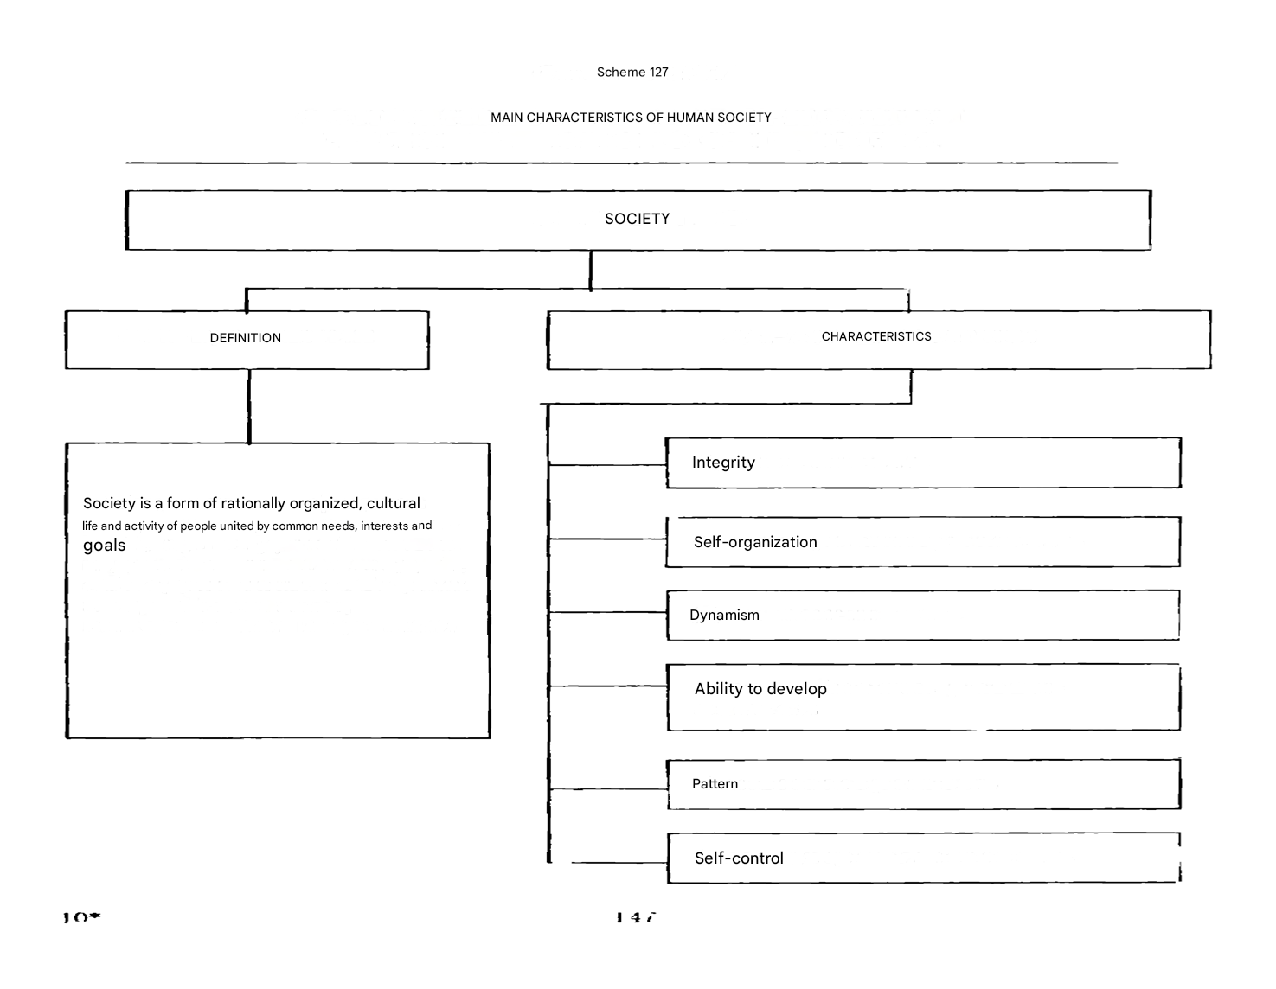

Slide 10
2. Basic philosophical concepts of the development of society

Slide 11
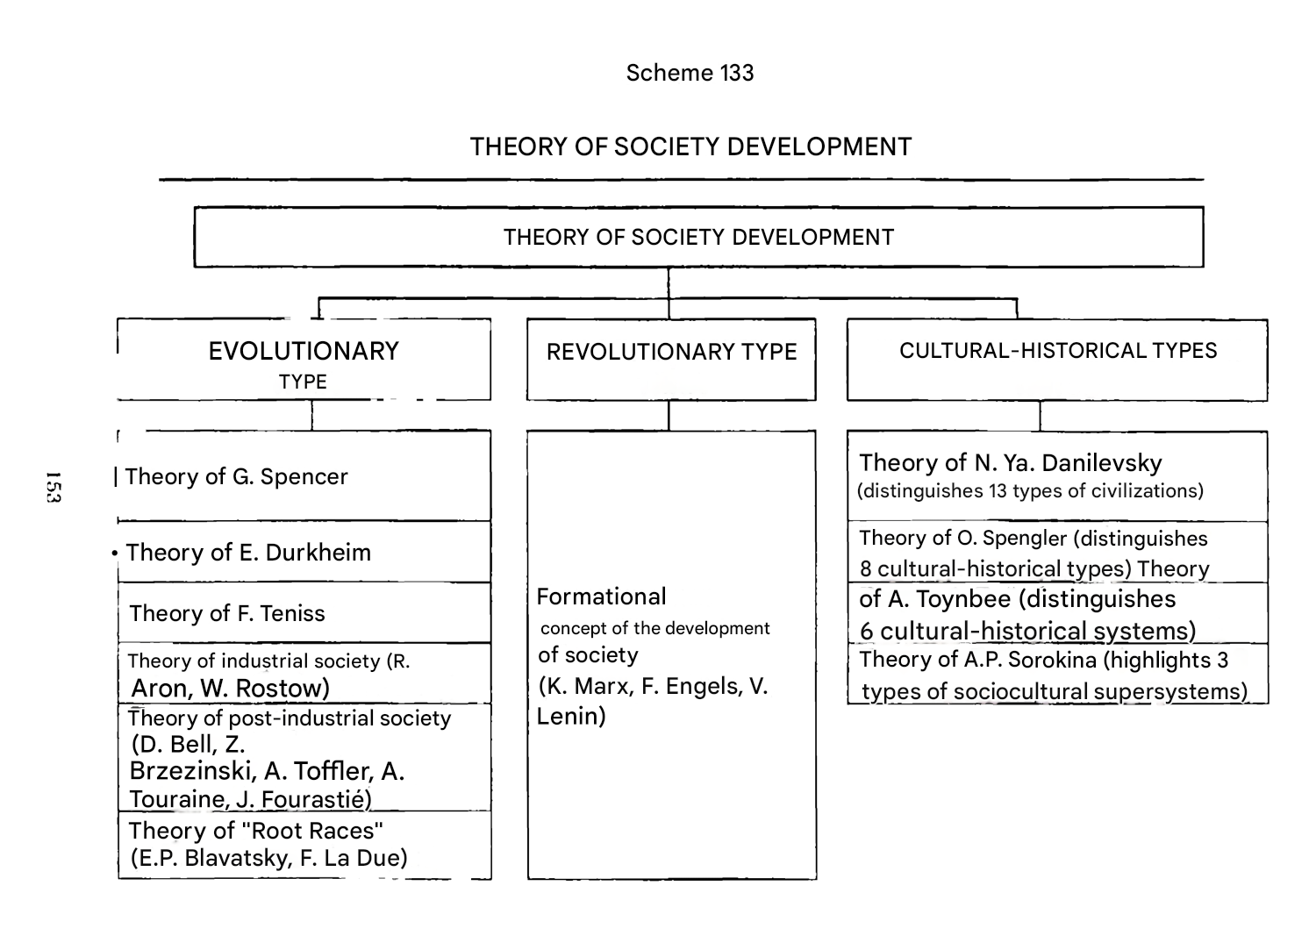

Slide 12
Naturalistic – human society is considered as a natural continuation of the laws of nature, the animal world and the Cosmos as a whole. Within the naturalistic view, in turn, three approaches can be identified that explain the laws of the unification of people:
a) the influence of the rhythms of the Cosmos and solar activity (L. Gumilev, A. Chizhevsky);
b) features of the geographical, natural and climatic environment (Charles Montesquieu, I. Mechnikov);
c) the specifics of man as a natural being, his genetic, racial and sexual characteristics (E. Wilson, R. Dawkins, etc.)
Society in naturalistic theory is considered as the highest, but far from the most successful creation of nature, and man as the most imperfect living being, genetically burdened with the desire for destruction and violence.

Slide 13
2. Idealistic – the essence of connections is seen in a complex of certain ideas, beliefs, spiritual principles (a single state ideology or religion, which play the role of the skeleton of the social structure). As long as the idea is "alive" – society is developing and flourishing, the idea is "dead" – society is "falling apart". Thus, the cause of all changes in society is the consciousness of people or the World Spirit (Hegel). The conclusion is made about the dominant role of consciousness and the need for spiritual improvement of each person.

Slide 14
3. Atomistic – society is a sum of individuals bound together by a contract to ensure survival (Hobbes). In this theory, society is a mechanical combination of individuals connected by conditional ties.

Slide 15
4. The Utopian concept of society (from the ancient Greek οὐ "not" + τόπος "place"; according to another version, from the ancient Greek εύ "good", that is, "good place") — comprehends the ideal social system in the past or imaginary future (uchronia), or in a country that allegedly already existed or exists somewhere (heterotopia), or as social transformations leading to the embodiment of the ideal in life. The idea of a utopian society was first formulated by T. More in his work "Utopia", and Campanella was an outstanding utopian. The utopian concept of society was further developed in the XVIII century in the teachings of Morelli and Meslier. The great utopians of the early 19th century were A. Saint-Simon, C. Fourier, and R. Owen.
The historical merit of utopian theories is the development of the idea of the possibility of transformation, change of society, drew attention to the vices and shortcomings of contemporary capitalist society. At the same time, the term utopian denotes the unreality, the unrealizability of a dream. The utopians, due to a number of conditions – economic, political, epistemological (underdevelopment of social knowledge) – were unable to offer real ways and mechanisms for improving social life.

Slide 16
5. Materialistic Its essence lies in the fact that the objective connections and foundations of the development of society are seen in the development of material social production. Thus, the primary basis of the development of society should be sought not in consciousness, but in the conditions of people's life, which to a decisive extent determine the motives of activity, behavior, as well as the desires, aspirations and goals of each person. From the form of material production, according to Marx, "... It follows: first, a certain structure of society; secondly, a certain attitude of people to nature. Their state system and their spiritual way of life are determined by both." The dialectical-materialist understanding of history begins with the solution of the basic question of philosophy as applied to society. "The consciousness of people depends on their being."
This statement follows from the simple fact that "people must first of all eat, drink, have a home and dress before they are able to engage in politics, science, art, religion..." And for this you need to work, to produce material wealth. The essence of the materialist understanding of history is that: Production and the subsequent exchange of its products form the basis of every social system. The historical process, social being, have an objective character. The main driving force that transforms the life of society is the masses of the people. The means for changing the existing state of affairs must be discovered in the available material factors of production.

Slide 17
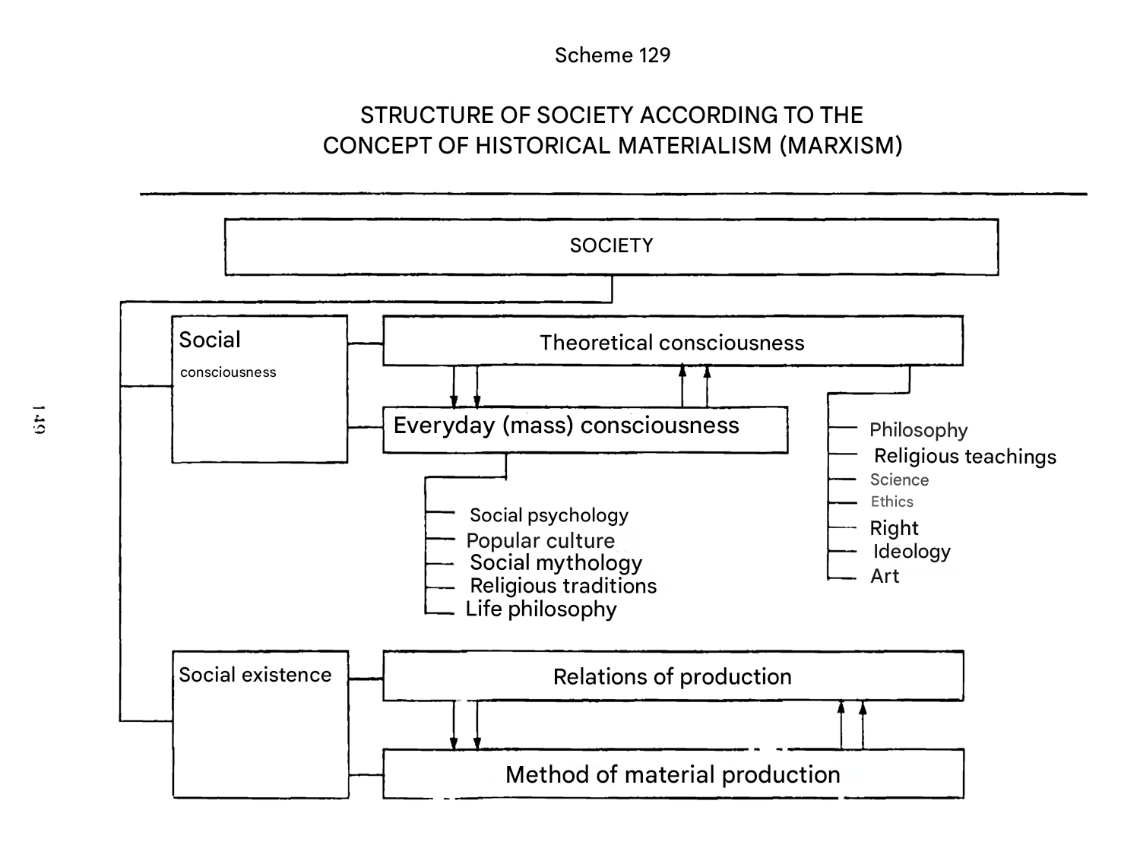

Slide 18
3. Culture, its essence

Slide 19
The original meaning of the Latin word "culture" is: cultivation, care, honor. Initially, the use of the word "culture" was limited to the sphere of agriculture, it was understood as a method of cultivation, cultivation of land, and only in the XVIII century it began to be filled with spiritual content and began to denote the improvement of human qualities. In the Age of Enlightenment, a person who was well-read and refined in manners was called cultured. In its modern meaning, the word "culture" was first used by the German historian and philosopher J.G. Herder (1744-1803), the work "Ideas for the Philosophy of the History of Mankind". In his opinion, it is culture that is the main unifying force of society, and the inner essence of culture itself, its core, is language.
In the 20th century, the concept of "culture" began to be interpreted very broadly – as a universal way of human existence in the world (in contrast to animals, whose culture can only be spoken of in a metaphorical sense), as an artificially created habitat transformed by man (in this sense, culture is synonymous with the noosphere).
In modern philosophy, the word "culture" is usually understood in two main meanings: broad and narrow. In the first case, culture turns out to be identical to social human life, in the second it is synonymous with the spiritual life of society and man.

Slide 20
Culture can be defined most succinctly and concisely as a material and spiritual environment created by man. In this respect, culture, on the one hand, opposes, and, on the other hand, builds up, grows out of nature as the natural habitat of man and society. In modern philosophy: two main approaches to the comprehension of culture:
Axiological approach: culture is a system of values, a complex hierarchy of ideals and meanings, significant for a particular social organism. Supporters of this approach pay special attention to the creative and personal aspects of culture, considering it as a measure of humanization of man and society. Activity approach: culture is a specific way of human life, "a system of extra-biologically developed mechanisms due to which the activity of people in society is stimulated, programmed and realized".

Slide 21
It is important to note that the main element of culture, its further indivisible "cell", is VALUE. In the system of philosophical knowledge, there is a whole section devoted to the study of values, which is called axiology (from the Greek axia, value, and logos, word, teaching). Axiology focuses on the nature of values, their varieties, and role in the life of society and man. The concept of value expresses the significance of objects of the surrounding world for a person, a social group, and society as a whole. This significance is determined not by the properties of objects per se, but by their involvement in the sphere of human life, interests and needs, and social relations. In other words, value matters because it is able to satisfy the needs of a person or society. Thus, it turns out that culture includes everything that is valuable for a person, that is important for him. Philosophy, considering the specific diversity of culture, distinguishes first of all between material and spiritual culture. Material culture includes material values, i.e. those objects and phenomena that satisfy our bodily needs. Among them, the most important place is occupied by means of production, technical devices and structures. Accordingly, spiritual culture includes spiritual values that can satisfy the needs of our soul. It should be noted that one and the same thing can be an element of both material and spiritual culture at the same time.

Slide 22
Each type of human activity requires the development of a certain type of culture (artistic, scientific, technical, political, etc.). Another important criterion for the differentiation of cultures is the national-state (ethno-social, regional), according to which American, Chinese, English culture is distinguished, or – Kazakh, Tatar, Bashkir, etc. The first is characterized by such values as traditionalism, collectivism, contemplation, respect for the elderly, etc., while Western culture rests on individualism, asserts progressivism (the desire for innovation), and more honors activity and the desire to transform the world.

Slide 23
On the subjective basis, we can talk about the culture of society and the culture of the individual, as well as about corporate, professional and other group cultures. If the culture of society is filled with values and norms, then the culture of the individual includes knowledge, skills and abilities, beliefs and value orientations of the individual. The culture of the individual is derived from the culture of society, and expresses the degree of mastery of the achievements of culture by the individual. There is also a distinction between elite and mass culture, the former is characterized by an orientation towards incomprehensibility, complexity, refinement of norms and values, while mass culture usually gravitates towards simplicity, comprehensibility, accessibility, and entertainment. Typical forms of mass culture include comics, travel novels, action films, "soap operas", while high elite culture includes classical literature, philosophy, painting, classical music, non-box office highly artistic films and theatrical performances.

Slide 24
The cultural level shows the degree to which a person has mastered the existing world of culture and society and his familiarization with high ideals and spiritual and moral values that elevate a person above the world of everyday life and ordinariness.
There are also such concepts as "subculture" and "counterculture". The first characterizes the culture of individual or more closed social groups (for example, youth culture, professional subcultures). Counterculture, on the other hand, has a protest character – it is a protest against the dominant institutions of power, property, and the alienation of a person. The counterculture often poses serious problems that exist in society, but are hushed up by the official authorities. The youth counterculture drew public attention to the global problems of our time, contributed to the creation of the "green" movement, actively opposes war, advocates disarmament, etc. A type of counterculture is the underground. It is an underground culture that is persecuted by the authorities and is in opposition to official politics. It is present in all countries of the world, but it is especially characteristic of states with totalitarian and authoritarian regimes. The official culture, supported and propagated by the state, is also opposed by folk culture, represented not only by folklore, but also by a variety of traditions, customs, norms, and values functioning in everyday life.

Slide 25
Development of culture. Culture contains both stable and changeable moments. Stability, "inertia" in culture is a tradition: elements of cultural heritage – ideas, values, customs, rituals, ways of perceiving the world, etc. – are preserved and passed on from generation to generation. Traditions exist in all forms of spiritual culture. We can talk about scientific, religious, moral, national, labor and other traditions. Thanks to them, society develops, each subsequent generation assimilates the achieved human experience, the norms of culture sifted out by time. The system of traditions reflects the integrity and stability of the social organism. It should not be rudely interfered with, since the subtle and complex mechanisms of culture can be disrupted.
It is not necessary to "improve" the spiritual life of society by completely destroying the old spiritual values and historical memory.
But culture cannot exist without innovation. Creativity and change are the other side of the development of society. The unity of tradition and innovation is a universal characteristic of any culture. Any innovation in culture that has a deep content and value is tested by time, re-evaluated by each subsequent generation of people.

Slide 26
Thus, philosophy considers culture as an integral phenomenon, opposed to nature and civilization, as a way of being in the world immanent to man, associated with the creation of a world of artifacts, including material and spiritual values, as well as a spiritual component of the world.

Slide 27
THEORIES OF CULTURE Check out the PPT: open the Slide Show and click on the numbers, then on the button at the bottom

